Slide 1
ZF SPORTIFY
Your one-stop solution for sports events and updates
alpha_hackz_20

Slide 2
Simplify the miscommunications
Main Aim :
Design and develop ZF sports platform which provides a one stop solution to get all details the tournaments and events

Slide 3
Event Updates
To Book the slots for events in ZF
The platform lists all the details for organization wide sports / games / competitive activities with status as ongoing / completed / cancelled / upcoming
We can reduce the miscommunication among the players & increase the productivity

Slide 4
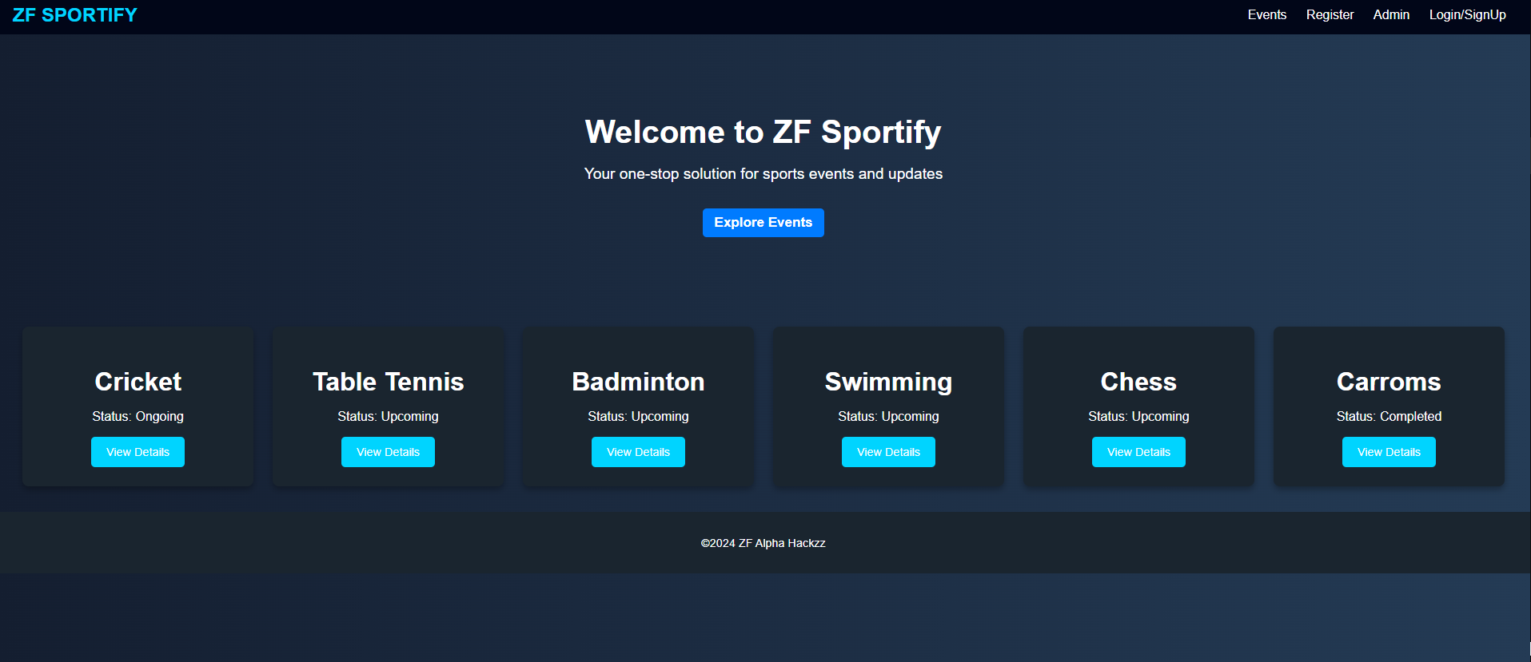
Outline of App

Slide 5
Tools & methods
Front end :
HTML & CSS
Backend:
Node.js & react.js
Database & Server management
MongoDb
Hosted on local PC

Slide 6
Best regards Team ALPHA HACKZZ_20
Shanthan Manne
Prakash Malasani
Rajib Saha
Hemanth Kumar Chintha
Maanvitha Garapati

